Slide 1
Case Study EDA
Sid Swarupananda
Sean mcWhirter

Slide 2
MSDS 6306: Doing Data Science - Case Study 01 Description
The Beers dataset contains a list of 2410 US craft beers and Breweries dataset contains 558 US breweries. The datasets descriptions are as follows.
Beers.csv:
Name: Name of the beer.
Beer_ID: Unique identifier of the beer.
ABV: Alcohol by volume of the beer.
IBU: International Bitterness Units of the beer.
Brewery_ID: Brewery id associated with the beer.
Style: Style of the beer.
Ounces: Ounces of beer.
Breweries.csv:
Brew_ID: Unique identifier of the brewery.
Name: Name of the brewery.
City: City where the brewery is located.
State: U.S. State where the brewery is located.

Slide 3
MSDS 6306: Doing Data Science - Case Study 01 Analysis
Breweries per state
Median alcohol content per state
Median international bitterness per state
Beers with highest Alcohol by Volume (ABV) and International Bitterness Unit (IBU)
Summary stats of Alcohol by Volume(ABV)
Analysis of relationship between Alcohol by Volume (ABV) and International Bitterness Unit (IBU)
Investigate the difference with respect to IBU and ABV between IPAs and other types of ale

Slide 4
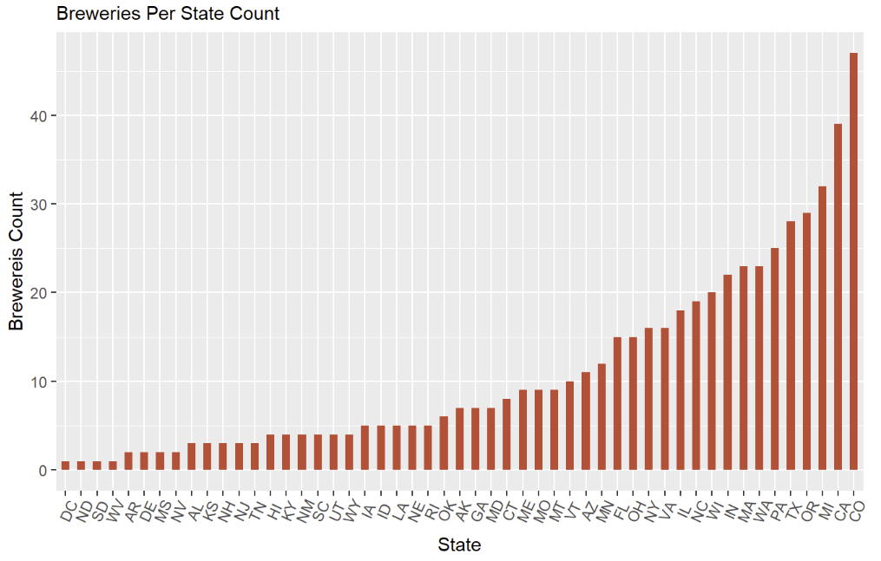
How many breweries are present in each state?
Colorado also has the most breweries
Looking further into this by comparing to population may lead to insights

Slide 5
Address the missing values in each column
Column | Missing Values
ABV | 62
IBU | 1005
ABV and IBU are the only columns with missing values.
However, since we have a high number of observations, we should be able to omit the missing values and still be able to determine any significant insights.

Slide 6
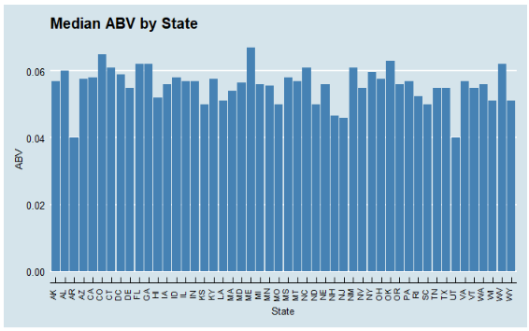
Compute the median alcohol content and international bitterness unit for each state. Plot a bar chart to compare

Slide 7
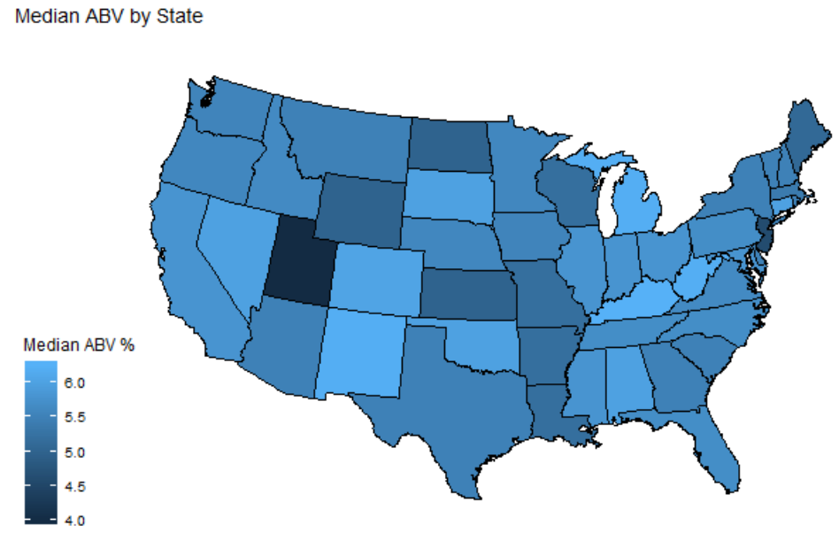
Median ABV by State
Colorado also has the most breweries
OK and NM have fewer breweries

Slide 8
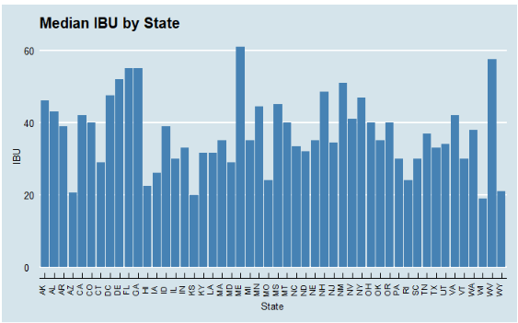
Median IBU by State
Certain states (ME and WV) seem to stand out above the rest
Relationship between IBU and ABV?

Slide 9
Which state has the maximum alcoholic (ABV) beer? Which state has the most bitter (IBU) beer?
Measure | State | Value
ABV | Colorado | 12.8%
IBU | Oregon | 138 IBU

Slide 10
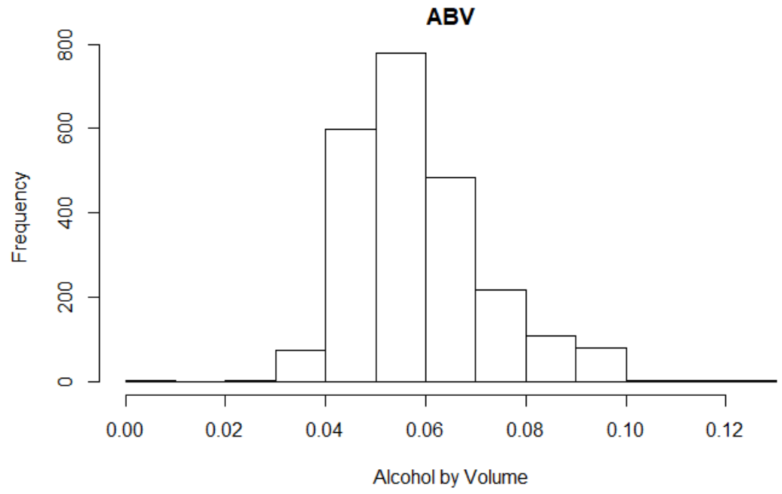
Comment on the summary statistics and distribution of the ABV variable
Appears to be slightly right-skewed
Mean: 5.991%
Median: 5.70%
This makes sense because beer is not meant to be a very high ABV drink—the high ABV beers would be less prominent

Slide 11
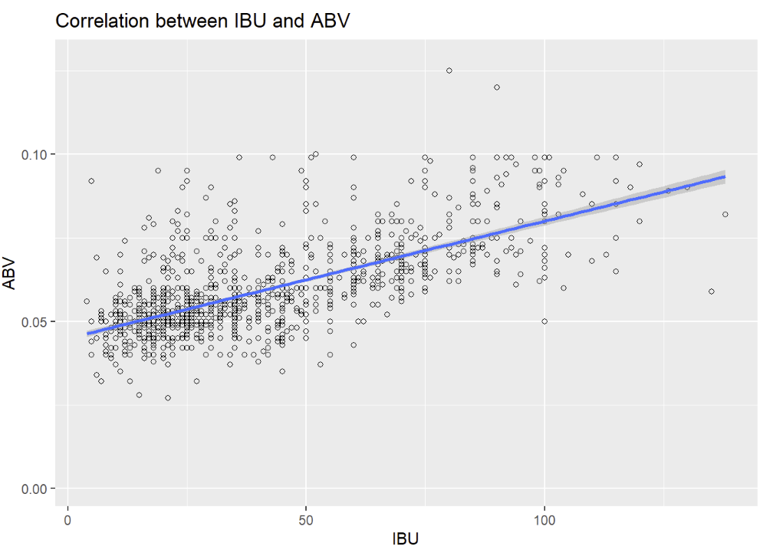
Is there an apparent relationship between the bitterness of the beer and its alcoholic content? Draw a scatter plot.
Visual evidence of a positive linear relationship
Further investigation is needed to determine the significance of the relationship

Slide 12
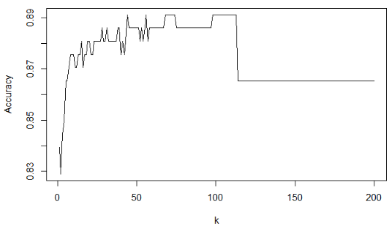
The difference with respect to IBU and ABV between IPAs (India Pale Ales) and other types of Ale (any beer with “Ale” in its name other than IPA).
Model called K-NN (Nearest Neighbor)
Approximately 105 should give us best accuracy
Accuracy of 88.6%

Slide 13
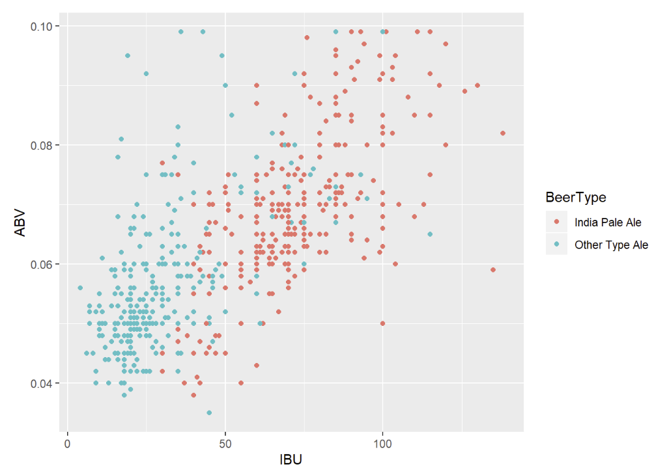
Budweiser would also like to investigate the difference with respect to IBU and ABV between IPAs (India Pale Ales) and other types of Ale (any beer with “Ale” in its name other than IPA).
Visually, IPAs seem to generally have higher IBU and ABV

Slide 14
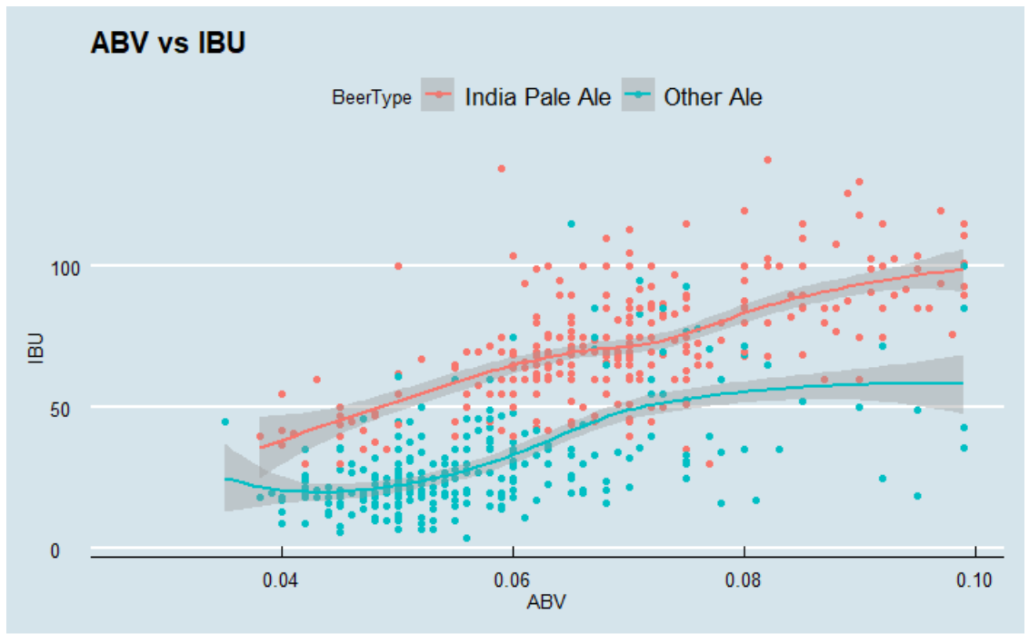
Budweiser would also like to investigate the difference with respect to IBU and ABV between IPAs (India Pale Ales) and other types of Ale (any beer with “Ale” in its name other than IPA).
First look seems to holds true when using the geom_smooth feature

Slide 15
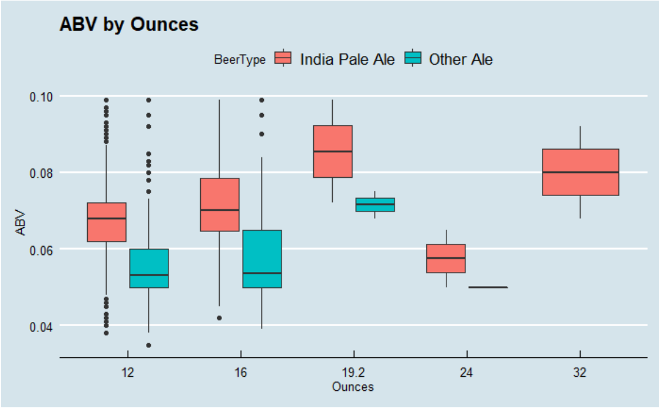
Other Insights
It appears that IPAs have higher median ABV values than other ales.
More of a difficult relationship between Ounces and ABV

